Slide 1
STUDENT NAME | FAWZUALEAMAN K
REGISTERATION NO | 20324U09019
NMID | 14C390B4738C18D90744190038D2D998
DEPARTMENT | BCA
COLLEGE | DR. M. G. R. CHOCKALINGAM ARTS COLLEGE
UNIVERSITY | THIRUVALLUVAR UNIVERSITY

Slide 2
PROJECT TITLE
STUDENT DIGITAL PORTFOLIO USING FRONT END WEB DEVELOPMENT (HTML, CSS & JAVASCRIPT)

Slide 3
AGENDA
Problem Statement
Project Overview
End Users
Tools and Technologies
Portfolio design and Layout
Features and Functionality
Results and Screenshots
Conclusion
Github Link

Slide 4
PROBLEM STATEMENT
Many students lack a structured way to showcase their academic achievements, skills, and projects effectively. Traditional resumes fail to highlight creativity and real-time learning progress. Employers and educators often find it challenging to assess students’ overall competencies. A digital student portfolio can bridge this gap by providing a centralized platform to display academic records, certifications, projects, and personal skills in an organized and interactive manner.

Slide 5
PROJECT OVERVIEW
This project is about developing a Digital Portfolio Website to showcase my personal and academic details in a professional way. It acts as an online platform where I can present my skills, projects, certifications, and education neatly in one place. The portfolio helps create a positive first impression for recruiters, teachers, and anyone who wants to know about my work. It is interactive, responsive, and easy to navigate, ensuring a better user experience. The main goal is to highlight my strengths and make it easy for others to contact me for opportunities. Technologies used include HTML, CSS, and JavaScript for building and styling the website. This project also helps in learning web development and improving technical skills. Finally, it serves as a personal branding tool for my career growth.

Slide 6
WHO ARE THE END USERS?
1) Recruiters and Employers – to evaluate the skills, projects, and achievements for job opportunities.
2) College Admission Officers – to review the academic background and certifications for higher studies. 3) Teachers and Mentors – to check, learning progress and academic work. 4) Clients or Companies – showcasing freelance or project-based work. 5) Peers and Collaborators – students, friends, or teammates who want to know skills or work experience. 6) General Audience – anyone interested in learning about me professionally.

Slide 7
TOOLS AND TECHNIQUES
HTML →Used for Structure (pages, sections)
CSS → It’s used for Styling (Designs, colours, layouts, responsiveness)
JavaScript → Interactivity (navigation menu, animations, form validation)
Visual Studio Code and Codepen → The Code Editors used to Alter, check, write the code
GitHub →An Version Control Platform used for To Host the project output
Microsoft Edge/ Google Chrome/ other Web Browser → These Web Browsers are used to Showcase the Project via Output

Slide 8
POTFOLIO DESIGN AND LAYOUT
1. Home / About Me
A clean introductory section with my name, profession, and tagline.
A short bio that highlights who am I, & what I do.
2. Projects
Showcasing my best work with thumbnails or cards.
Use a grid or card layout for easy browsing.
3. Skills
Display my technical and soft skills clearly.
Can be shown using icons, progress bars, or categorized lists (e.g., Web Development, Tools, Languages).
Keep it visually engaging but simple.

Slide 9
4. Certifications
This section describes about my completed courses or certifications.
Present as a list or cards with certificate name, issuing authority, and date.
5. Education Details
Structured list or timeline of my academic qualifications.
Mentioned course, institution, & duration
6. Resume
A dedicated section with a downloadable PDF link of my resume.
Optionally, embed a preview of your resume.
Keep the “Download CV/Resume” button highlighted.
7. Responsive Layout (Mobile + Desktop View)
Desktop View: Grid-based layout, larger images, side navigation or top navbar.
Mobile View: Stacked sections, collapsible menu (hamburger icon), touch-friendly buttons.
Ensure text, images, and buttons adjust smoothly to all screen sizes.

Slide 10
FEATURES AND FUNCTIONALITY
The Home and About Me section introduces the student with a brief bio, and career objectives, giving visitors an overview of their personality and goals. The Skills section highlights the student’s technical and soft skills using visual elements. In the Project section are displayed the What projects are done. The Certification section features achievements, and online course completions, providing evidence of additional learning. The Education section lists academic qualifications, and institutions for a clear academic background.
Resume shows about my all details. Finally, the Contact Us section includes an interactive form or contact details so visitors can reach out easily for opportunities, feedback, or collaborations.

Slide 11
RESULTS
The result of a digital portfolio is basically what you achieve or showcase after creating it. In simple terms, it is the outcome or benefits that a digital portfolio provides. For a student, the result includes:
Showcasing Skills & Projects: Talents, projects, and certifications are displayed clearly in one place.
Better Opportunities: Helps in college admissions for PG’s, internships, and job applications by presenting your profile professionally.
Easy Access: A single link for teachers, recruiters, or peers to view your work anytime.
Personal Branding: Builds a strong online presence and highlights your strengths.
Feedback & Improvement: Enables you to get comments or suggestions to grow further.

Slide 12
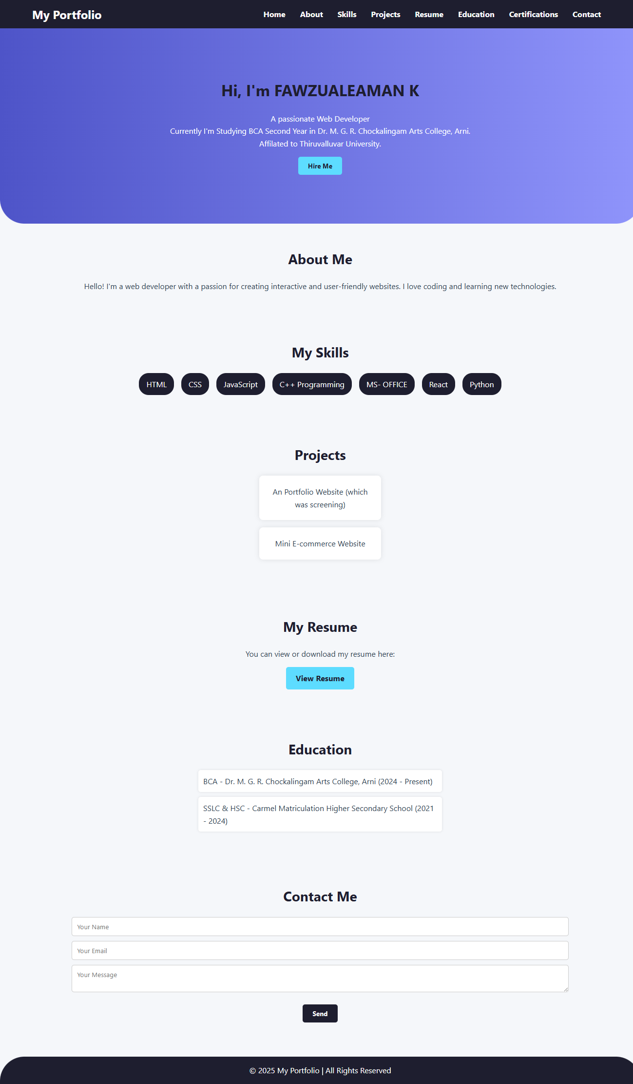
SCREENSHOT/ OUTPUT
In this image, represents the output of the Digital Portfolio…

Slide 13
CONCLUSION
A digital portfolio is a modern platform for showcasing a student’s skills, education, projects, and achievements in one place.
It helps create a strong personal brand and improves visibility for career or academic opportunities. With its interactive and professional design, it highlights growth, creativity, and technical expertise effectively.

Slide 14
PROJECT LINK
https://github.com/FAWZUALEAMAN-K/Digital-Portfolio.git
OUTPUT LINK OF THE PROJECT
https://fawzualeaman.github.io/Digital-Portfolio/

